Slide 1
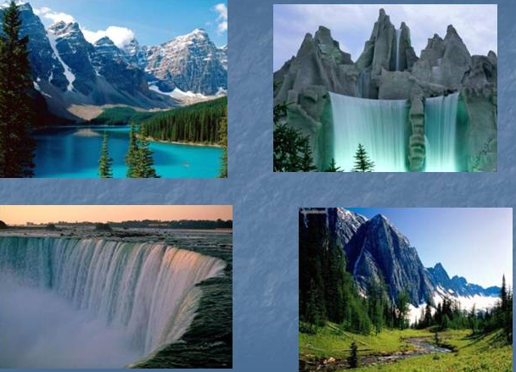
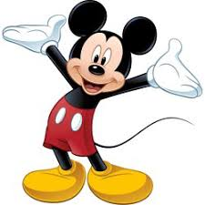
We study English
Quiz lesson

Slide 2
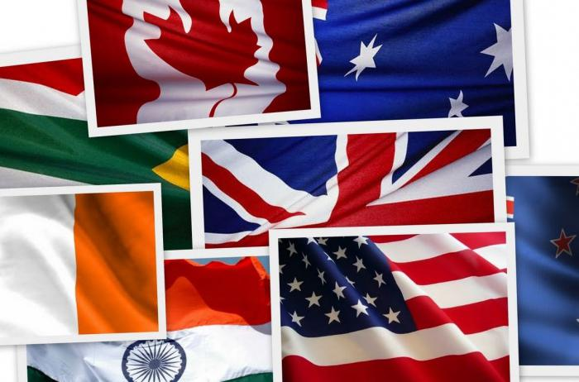
Purpose:
Consolidation of existing knowledge in the field of English through a game and team work. Develop the speech of children and knowledge gained in English lessons.
Tasks:
To develop students' mental abilities, develop quick thinking, the ability to give short and complete, detailed answers to questions
Let students show their creativity
Form a tolerant attitude to the opinions of other students, develop the ability to listen to each other, develop the ability to work in a team and make a joint decision
To cultivate respect for the culture of one’s country and the countries of the language being studied.

Slide 3
Plan of quiz lesson:
The ESC game
Let’s play one, two, three…
Favourite heroes
Guess the hidden words
The right choice
Solve the riddles
What time is it?
Plural of the words
Complete the months
Match them to the definitions
Write countable and uncountable nouns

Slide 4
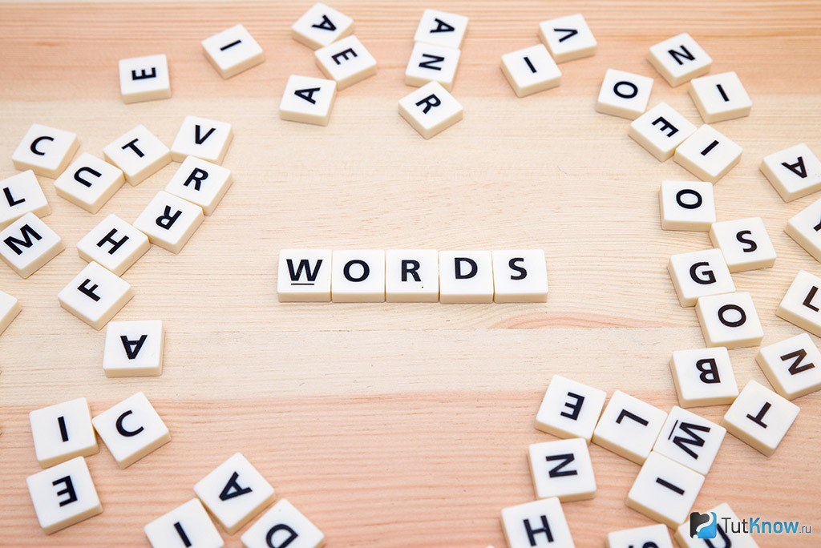
The ESC game
You should collect the letters from the English alphabet and put it in right order to find the name of the English-speaking countries. You have 1 minute for task.

Slide 5
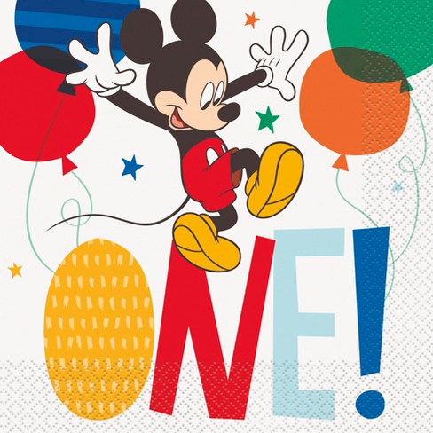
Let’s play one, two, three…
Look at the board and choose any number. Each team will take one number and answer it in turn.
Name 3 regular verbs
Name 3 adjectives
Name 3 irregular verbs
Name 3 sports
Name 3 professions
Name 3 things that people wear
Name 3 English-speaking countries
Name 3 famous people in Kyrgyzstan

Slide 6
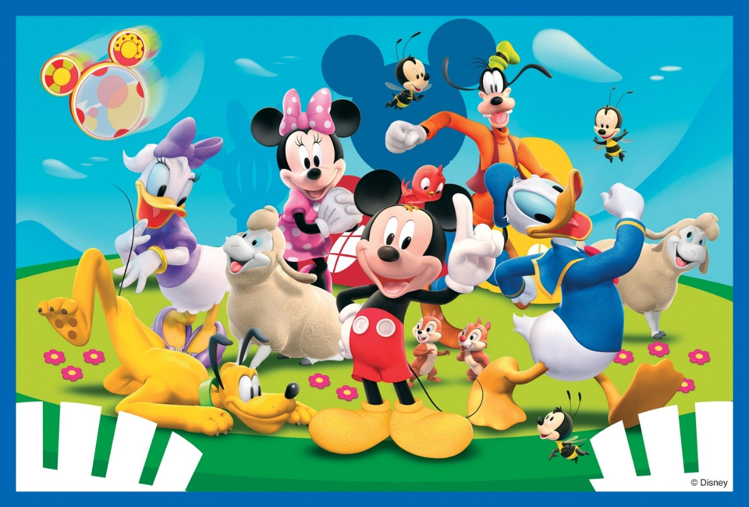
“Favourite heroes”
You should connect these parts to each other to get favourite heroes. Who will be the first?
Minnie a) the Seven Dwarfs
Snow White and b) Duck
Puss in c) Pooh
Peter d) Mouse
Donald e) Boots
Winny-the- f) Clause
Santa g) Pan

Slide 7
Guess the hidden words
Search the hiding words in the following sentences.
Example: If I shout, he’ll hear me.(Fish)
1. Close the door at once!
2. He’ll come to America tomorrow.
3. Do good workers succeed?
4. If Roger comes, we’ll begin.

Slide 8
"The right choice”
Read the sentences and choose right variant.
The capital of England is a) London b) Paris c) Moscow.
London stands a) the Volga b) the Mississippi c) the Thames.
The symbol of England is a) a red rose b) a tulip c) a daffodil.
The English flag is a) blue and white b) red and green c) red and white.
Golf comes from a) Scotland b) Russia c) the USA.
A. Bell invented a) a car b) a telephone c) a plane.
Ch. Chaplin was a) an artist b) a composer c) an actor.
Cricket comes from a) England b) Italy c) France.
"Robinson Crusoe” was written by a) Lewis Carroll b) Daniel Defoe c) Alan Milne.
The traditional Christmas meal in England is a) roast turkey b) fish and chips c) porridge.

Slide 9
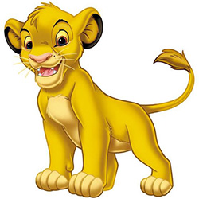
"Solve the riddles”
You should guess the riddles. The team which answers the first and correctly wins. You can get 1 point for each right answer.
I have got four legs but I can’t walk.
I’m tall and green, I’m in the garden.
It does not have legs, but it goes.
Two brothers, but they don’t see each other.
It’s white, cold and sweet. All children like it.
It’s not a man, it’s not a woman, but it teaches us.

Slide 10
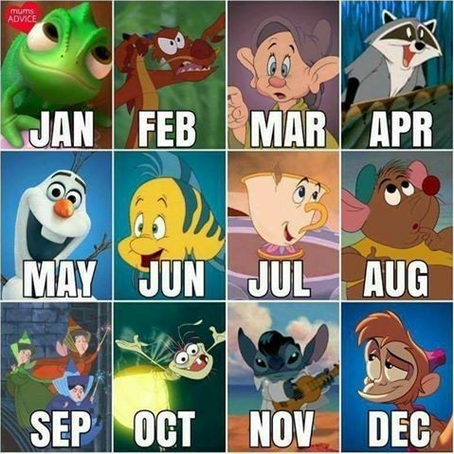
Complete the months:
-ember (x3) -y -e -ly -ober
-aury -ust -ruary -ch -il
Jan
Apr
Ju
Oct
Feb
Ma
Aug
Nov
Mar
Jun
Sept
Dec

Slide 11
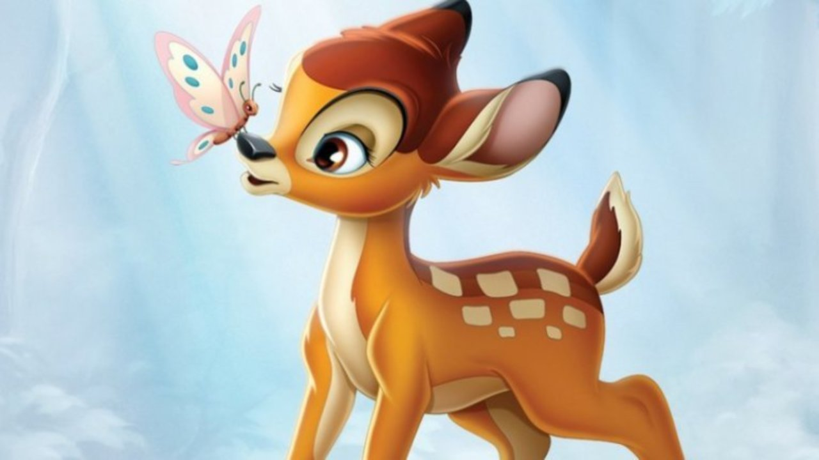
Write the plural of the words:
A table
An umbrella
A watch
A key
A dictionary
A box
A child
A man
tables
umbrellas
watches
keys
dictionaries
boxes
children
men

Slide 12
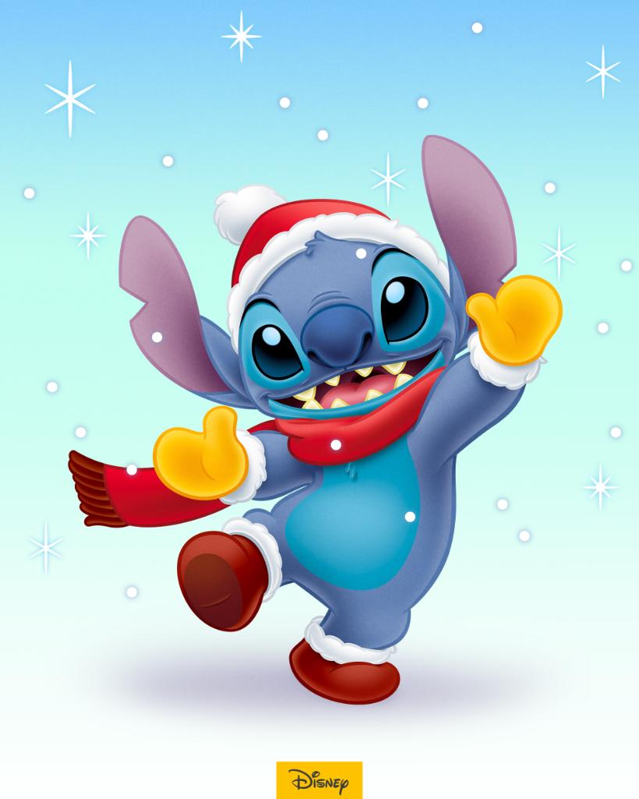
Divide these nouns on countable and uncountable:
Bread, jam, sweets, rice, oil, mushrooms, cereal, sausages, water, sugar, bananas, garlic, apples, cucumbers
Countable:
Sweets
Mushrooms
Sausages
Bananas
Garlic
Cucumbers
Apples
Uncountable:
Rice
Bread
Oil
Jam
Cereal
Water
Sugar

Slide 13
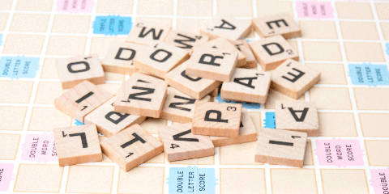
Match the words with their definitions:
a) very big
b) important in a religion
c) to continue
d) presents
e) a Muslim religious building
f) people who live near you
g) to speak to God
h) to happen
1) huge
2) mosques
3) gifts
4) take place
3) pray
6) neighbours
7) lasts
8) holy

Slide 14
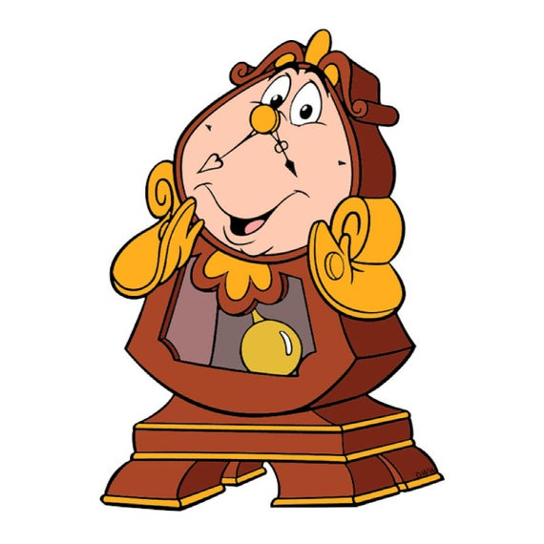
What time is it? Write in numbers:
Quarter past ten
Twenty to three
Half past four
Quarter to nine
Six to seven
Ten to eleven
Half past eight
Twenty-five past five
Ten to two

Slide 15
The End!
Thank you for your attention!

